Slide 1

PRSENTATION TOPIC : HISTORY OF OPTICAL FIBER Course Title : English Language and Literature Course Code : ICT-1211
Presented By :
MD MONIRUZZAMAN
ID : IT-25016
Department of Information and Communication Technology
Mawlana Bhashani Science and Technology University
Supervised by :
Dr. NAZRUL ISLAM
Associate Professor,
Department of Information and Communication Technology
Mawlana Bhashani Science and TechnologyUniversity

Slide 2
BRIFE FLOW OF PRESENTATION
Introduction
Evolution of optical fiber
Structure of optical fiber
Working principle
Advantages and Disadvantages
Application of optical fiber
Future of optical fiber
Conclusion

Slide 3
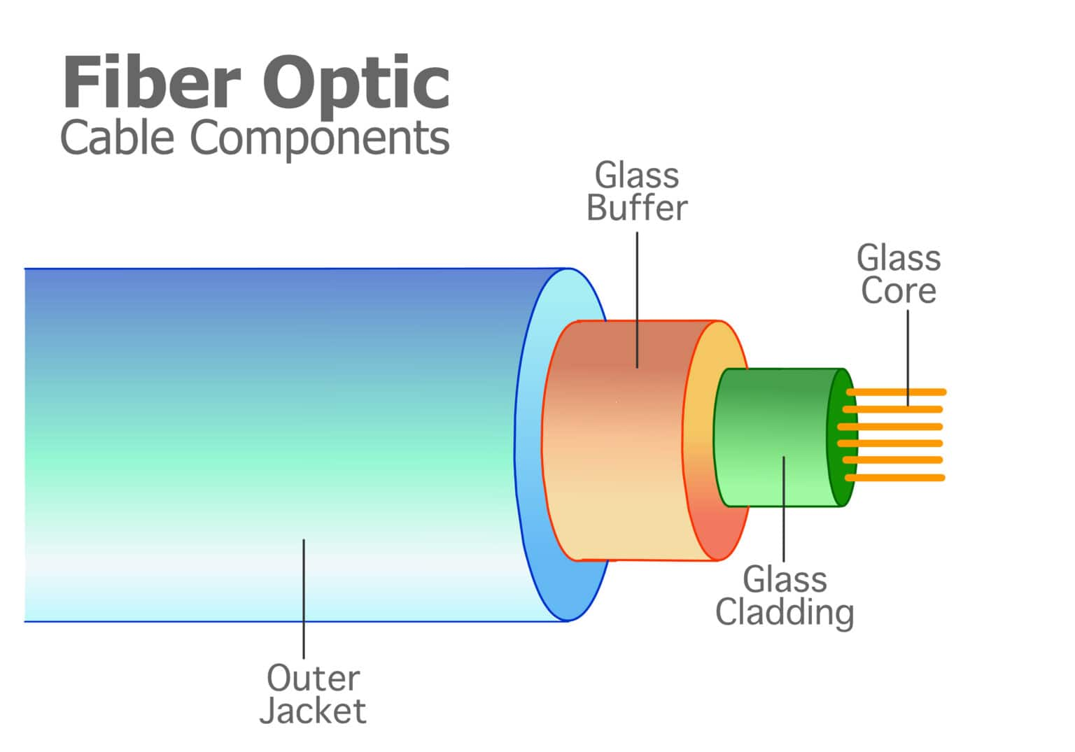
INTRODUCTION
[1]
.Optical fiber is a thin stand of glass or plastic.
.It carries information using light signals.
Used in internet, telephone,medical tools,etc.
[1]

Slide 4
Evolution of optical fiber[2]
1880- Alexander Graham Bell
1930- Patents on tubing
1950- Patents for two-layer glass wave-guide
1960- Laser first used as light source
1965- High loss of light discovered
1970s- Refining of manufacturing process(John Tyndall demonstration
in 1870)
1980s- Of technology becomes backbone of long distance telephone networks in NA

Slide 5
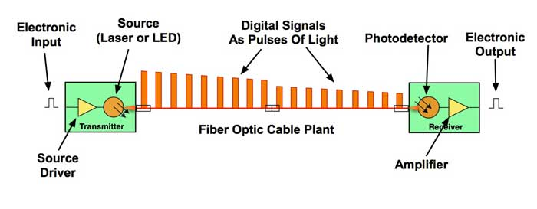
How Optical Fiber Transmits Data
signals using a laser/LED
Light travels through the fiber core
Data (0s & 1s) is converted into light
It reflects inside the cable by → Total Internal Reflection
Light reaches the receiver at very high speed
A photodetector converts light back into
electricalsignals (data)
[3]

Slide 6

Early Idea of Light Transmission
Scientists studied light reflection for centuries.
First concept came from guiding light through water.
[4]

Slide 7
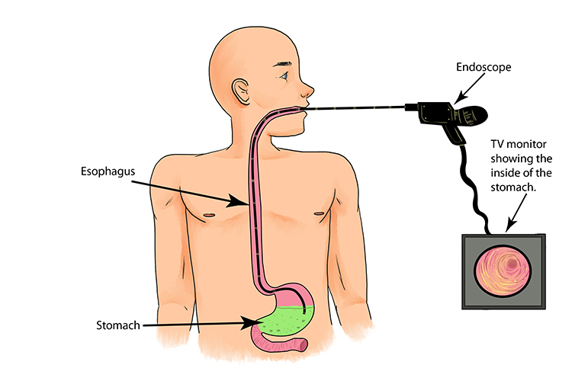
Early Medical Uses(1920s)
Doctors wanted to use inside the human body.
Light pipes were used in medical instruments.
[5]

Slide 8
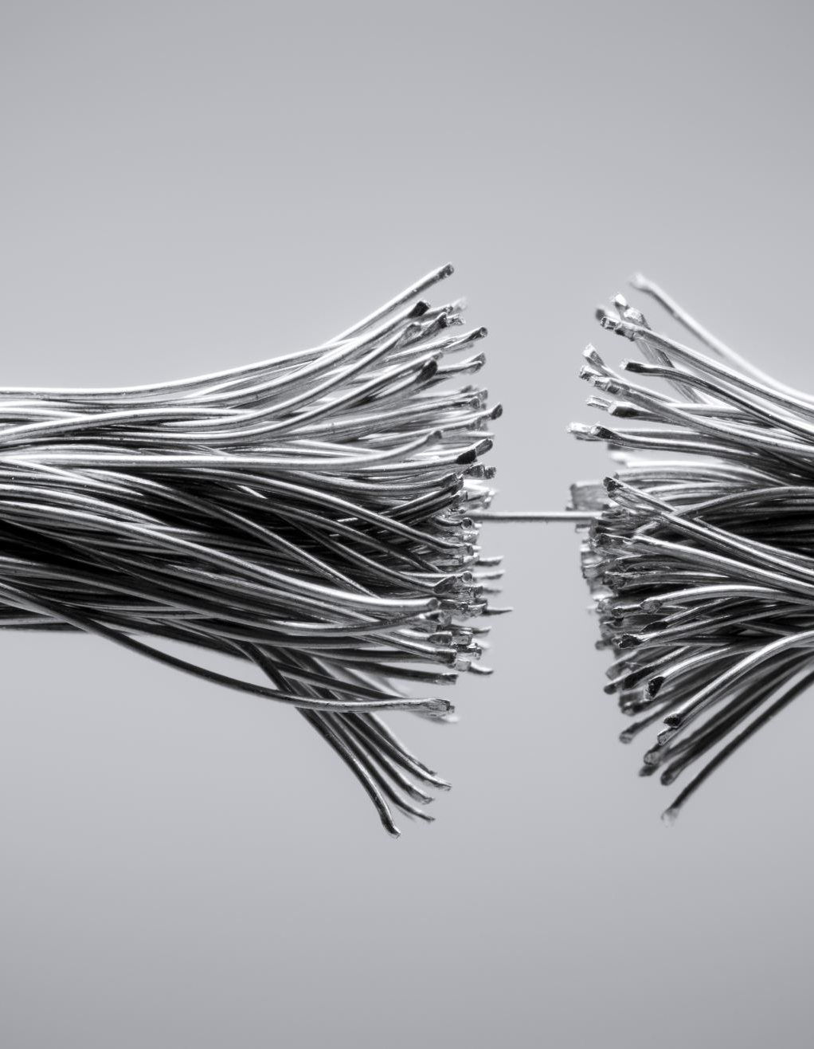
First Practical Fiber (1980s)
Developed companies started using fiber.
Better than copper wires.
[6]
Notes:
In 1970, researchers at Corning Glass Works developed the first practical low-loss optical fiber. This was a major breakthrough because it made long-distance fiber communication possible.

Slide 9
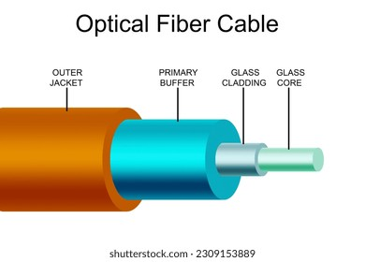
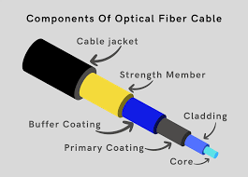
Structure of optical fiber
[7]

Slide 10
How it works
Core-central tube of thin size made up of optically transparent dielectric medium and carries the lite from transmitter to receiver. The core diameter can vary from about 5um – 100um
Cladding- outer optical material surrounding the core having reflecting index lower than core. It helps to keep the light within the core throughout the phenomena of total internal reflection.
Buffer Coating-plastic coating that protects the fiber made of silicon rubber. The typical diameter of fiber after coating is 250-300um.

Slide 11
Working principle
Optical fibers use a principle from physics called total internal reflection.
Light enters one end of the fiber.
It reflects repeatedly off the inner walls.
The light travels long distances with very little loss.
This happens because of two layers.
Core-inner part where light travels.
Cladding – outer layer that reflects light back into the core.

Slide 12
Present Use
Broadband internet.
Mobile networks.
Cable TV.
Medical endoscopy.
Military communication.
Notes:
Today optical fiber is used in many sectors.It provides broadband internet ,supports mobile networks,cable television,medical endoscopy and scure military communication systems.

Slide 13
Types of optical fibers
Single-model fiber
Very thin core
Carries one light path(mode)
Used for long distance communication
Multi-mode fiber
Thicker core
Carries multiple light paths
Used for shorter distances (like within buildings)

Slide 14
Advantages of Optical Fiber
Very high speed.
Low signal loss.
Lightweight .
Secure communication.
No electromagnetic interference.
[13]

Slide 15
Disadvantages of Optical Fiber
High installation cost compared to copper cables
Difficult to install and repair (requires skilled technicians)
Fragile – fibers can break easily if bent too much
Cannot carry electrical power (only transmits light signals)
Splicing and connection are complex

Slide 16
Future of Optical Fiber
Faster 5G and 6G support. [12]
Smart cities.
Al and cloud system.
Better global communication.

Slide 17
Important inventors
John Tyndall.
Heinrich Lamm.
Narinder Kapany.
Charles Kao.

Slide 18
Conclusion
Optical fiber is a fast and reliable communication technology
It transmits data using light signals
Provides high speed and low signal loss
Widely used in internet, telephone, and medical systems
Plays an important role in modern global communication

Slide 19
References:
[1] https://www.zayo.com/resources/fiber-optic-networks-a-comprehensive-guide/
[2] https://www.slideshare.net/slideshow/optical-fiber-communiction-system/26226232
[3] https://www.thefoa.org/tech/ref/appln/datalink.html
[4] https://www.istockphoto.com/photos/dark-stage
[5] https://mammothmemory.net/physics/refraction/medical-use-of-optical-fibres/medical-uses-of-optical-fibres.html
[6] https://www.gsproducts.co.uk/blog/load-testing-facilities/wire-rope-break/
[7] https://www.shutterstock.com/image-illustration/diagram-optical-fiber-cable-3d-rendering-2309153889
https://fiberopticx.com/optical-fiber-cable-structure/

Slide 20
